Slide 1

Smart Lightning Prediction and Alert System
Theme- Environmental Challenge.

Slide 2

Team Name: Dexterous Squad.
Member Details:
Member 1- Ankit Pandey
Member 2- Archana Prajapati
Member 3- Amrit Chandra Kumar
Member 4- Swati Kumari Gupta

Slide 3

PROBLEM STATEMENT :
01
02
03
Lightning accounts for most of the casualties
caused by natural calamities as claimed by IMD statistical data- death
rate: 0.25 per million population per year in India. (1979-2021).
People who use smartphones benefit from Damini(made by IITM) but our target audience i.e the farmers who work on the field are unable to use Damini or other such services, making them prone to danger.
According to recent data, we can say that the mortality rate of farmers has increased in recent years due to lightning, so farmers are at higher risk.

Slide 4
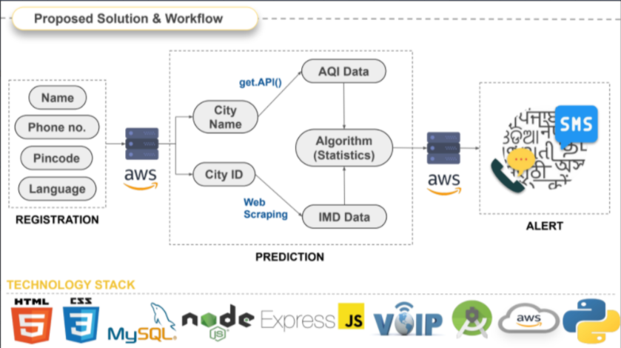



WORKFLOW
3. The threshold value is decided through applying Machine Learning technique. The solution improves the accuracy of lightning prediction compared to existing systems.
1. We use live doppler radar and satellite data published by Indian Meteorological Department and then combine it statistically with Air Quality Index data of that area and come up with a joint probability.
2. This joint probability is then compared with a threshold value. On the basis of this comparison we predict the occurrence of lightning.

Slide 5

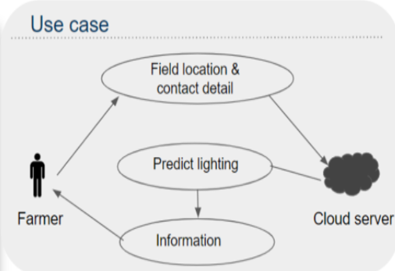
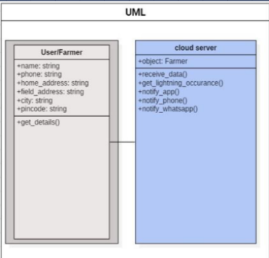
METHODOLOGY

Slide 6
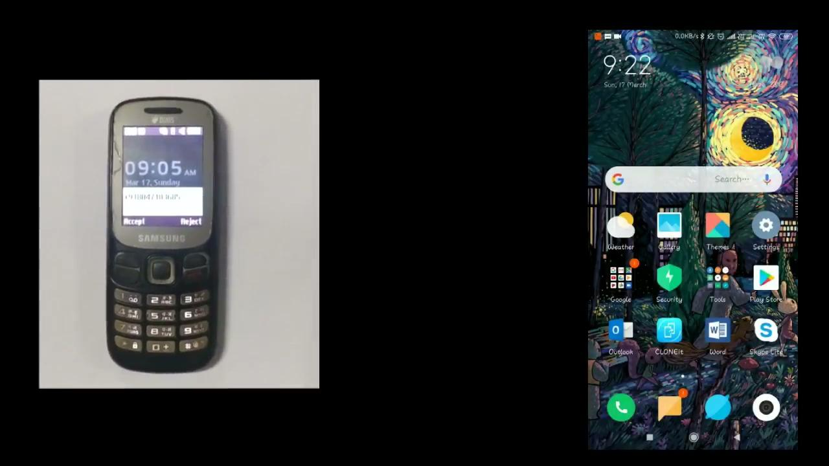
WORKING PROTOTYPE
https://drive.google.com/drive/folders/1_yztwLdDDgCURO8WwpduQaQ_3DGETVgm (DEMO VIDEO)
SOURCE CODE-- https://github.com/ANKITSPANDEY/dexterous_squad
https://drive.google.com/file/d/13mCli8mstVy2JaoC7MklMUsnDEzKmrxW/view?usp=sharing

Slide 7
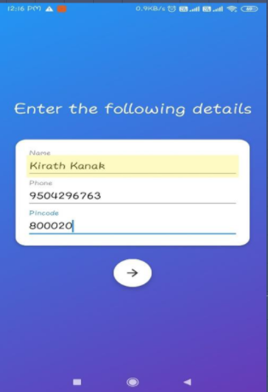
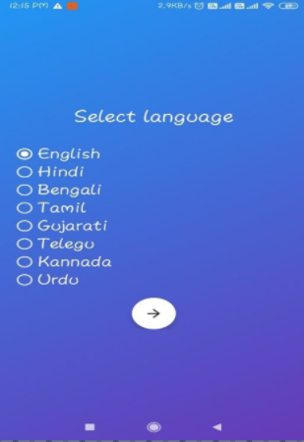

ATTACHMENTS
FOR SMARTPHONE USERS

Slide 8

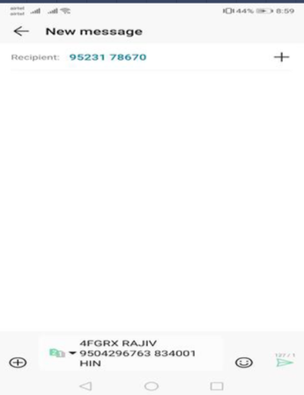
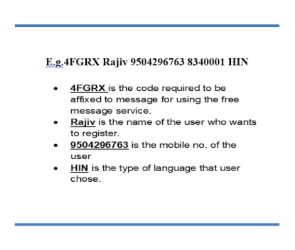
FOR NON SMARTPHONE USERS

Slide 9



300,000
Financial Projections and Key Metrics
Topic 1
1,000,000
Topic 2
Briefly elaborate on what you want to discuss.
$850,000
Provide a three-year forecast containing dollars and key metrics such as the number of customers and conversion rate. Do a bottom-up, not top-down, analysis.
Topic 3
Kindly delete this note after editing this page.
9

Slide 10


Sitwell
Games
Other Competitors
Topic 1
Topic 2
Topic 3
Topic 4
Topic 1
Topic 2
Topic 3
Topic 4
Provide a complete view of the competitive landscape. And saying that you‘re “more passionate” is utterly meaningless.
Kindly delete this note after editing this page.
7

